Slide 1
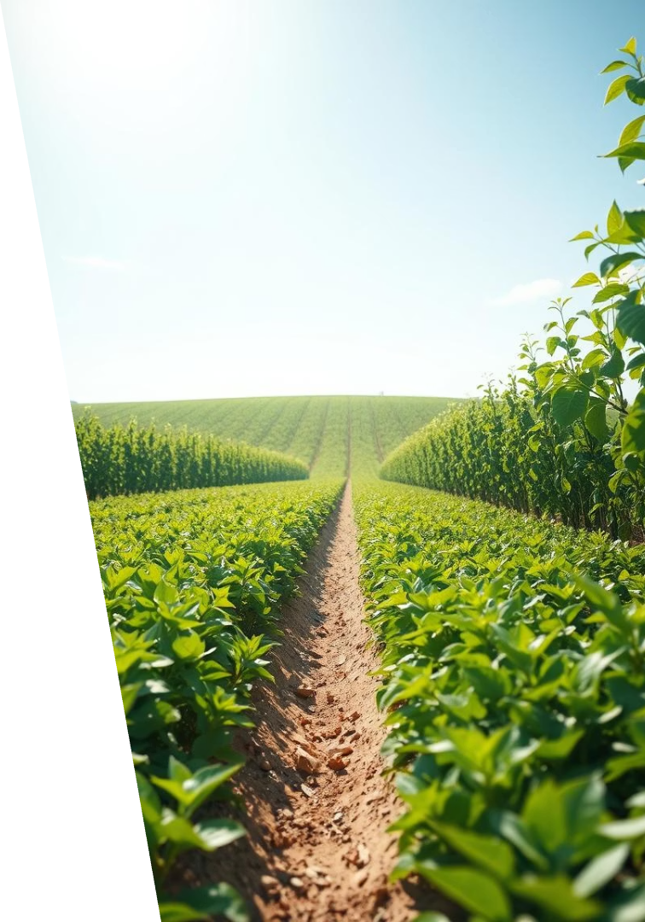
AgroShield: Protecting Crops with Real-Time Disease Prediction
Presented By:
Josthna K
M Samyuktha
Spoorti S H
Shubeka Iram
A Thejaswini

Slide 2
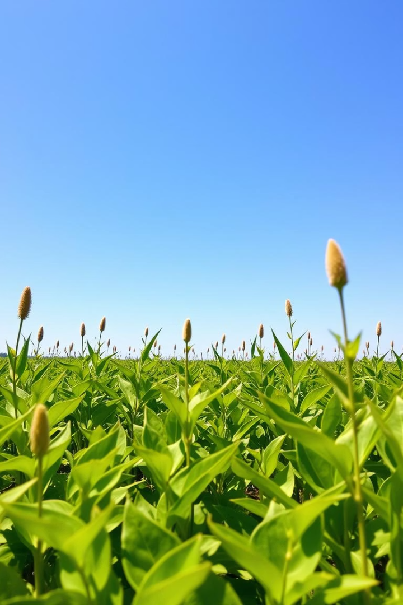
INTRODUCTION
Agriculture is still the main source of income for many people.
Farmers face big losses every year due to crop diseases.
These diseases are caused by bad weather, poor soil, and wrong use of pesticides.
AgroShield is our project to help farmers reduce these risks.
We used real-time farmer reports, weather data, and past crop records.

Slide 3
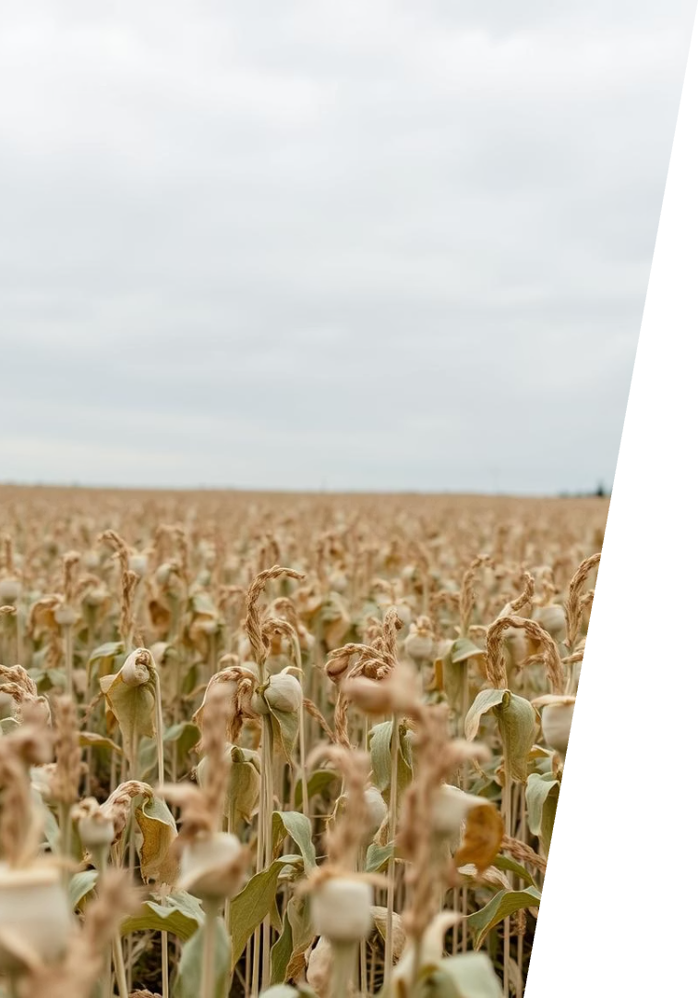
Problem Statement
AgroShield aims to predict crop disease outbreaks by analyzing local weather conditions and farmer-reported symptoms.
By integrating historical disease data, weather trends, and pesticide usage, the system helps farmers and authorities take early preventive actions to reduce crop losses and improve agricultural productivity.

Slide 4
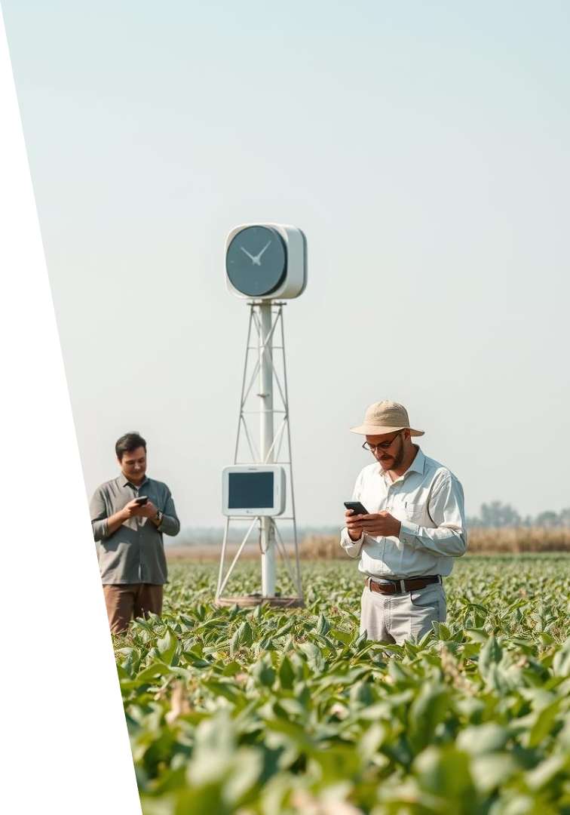
Data Sources: Weather, Farmers, and Sensors
Weather Data
From 5,000+ stations covering temperature, humidity, and rainfall.
Farmer Reports
Mobile app inputs of disease sightings and crop status.
Sensors
Soil moisture and leaf wetness sensors integrated into fields.
Data Quality
Robust validation and cleaning protocols ensure accuracy.

Slide 5
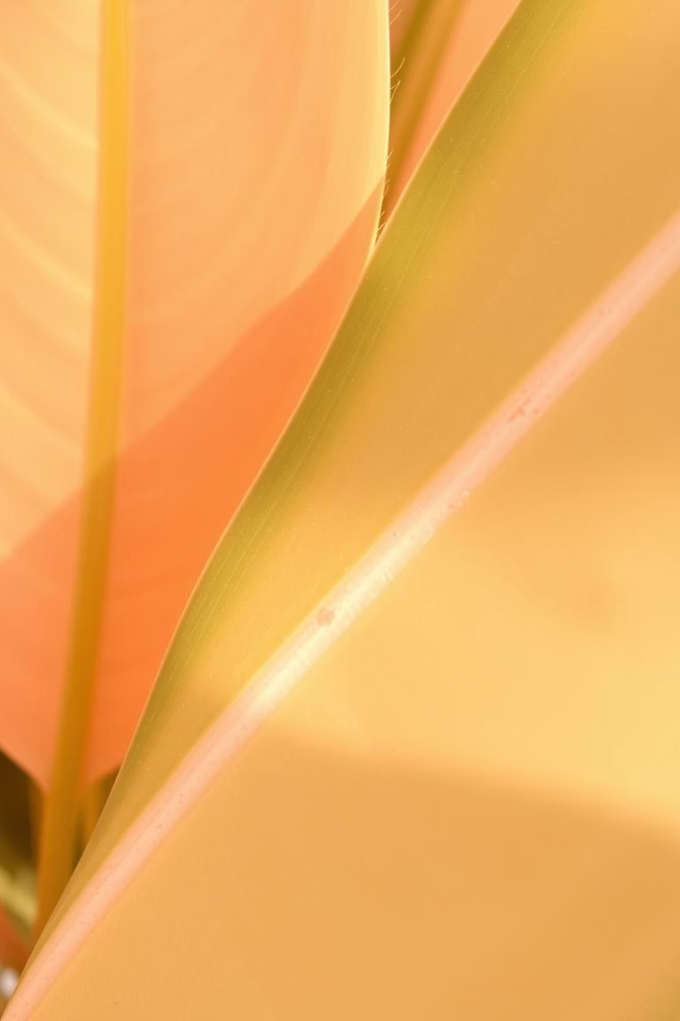
Advantages: Early Disease Detection
Detects diseases up to 2 weeks before symptoms appear, enabling timely action.
Reduces pesticide use by 30–40% through precise, targeted application.
Minimizes crop losses while increasing yields by an average of 15%.

Slide 6
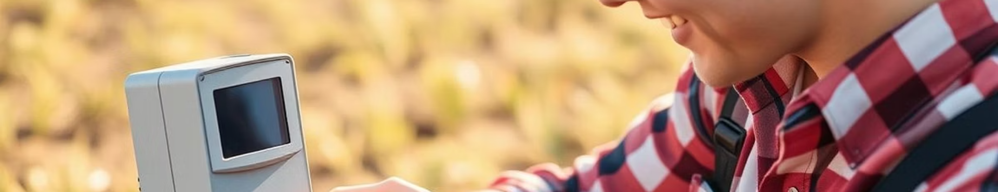
Disadvantages: Data Dependency and Accuracy
Accuracy depends on quality and consistency of input data.
False positives/negatives possible in complex, dynamic environments.
Requires sensor maintenance and limited in regions with scarce data.

Slide 7
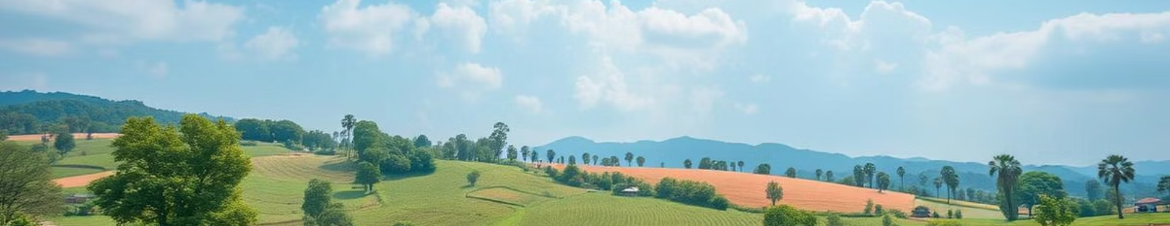
Applications: Sustainable Farming Practices
Environmental Benefits
Soil Health
Climate Smart
Lower pesticide use reduces chemical impact and promotes biodiversity.
Data-driven decisions maintain long-term soil fertility and ecosystem balance.
Optimizes resources, supporting climate-resilient agriculture systems.

Slide 8
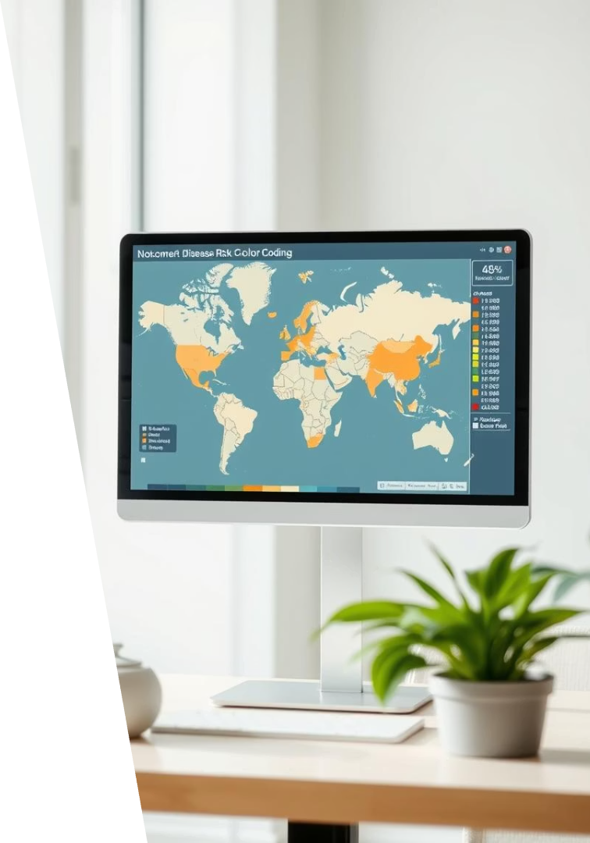




AgroShield User Interface: Web Dashboard
Disease Risk Maps
Weather & Forecasts
Alert System
Receive SMS and email notifications for critical events.
Visualize risk levels by region easily.
Access detailed weather data integrated with disease outlooks.
Crop-Specific Advice
Customized recommendations tailored to crop types and locations.

Slide 9

Conclusion
AgroShield combines data and tech to combat crop disease.
End-to-end pipeline from farmer inputs to decision dashboards.
Enhances food security and rural livelihoods.
Scalable for broader agri-tech innovation.

